Slide 1
IT VEDANT - CHENNAI
Flask Project on Profile Creation using
HTML and Python
Presented by
Logesh Kumar.N

Slide 2
ABSTRACT
Profile creation using HTML as front end, python as a language for CRUD operation with MySQL as Database.

Slide 3
OBJECTIVE
The main objectives of this project is:
To understand and develop the skills in designing a dynamic Web Page using HTML.

Slide 4
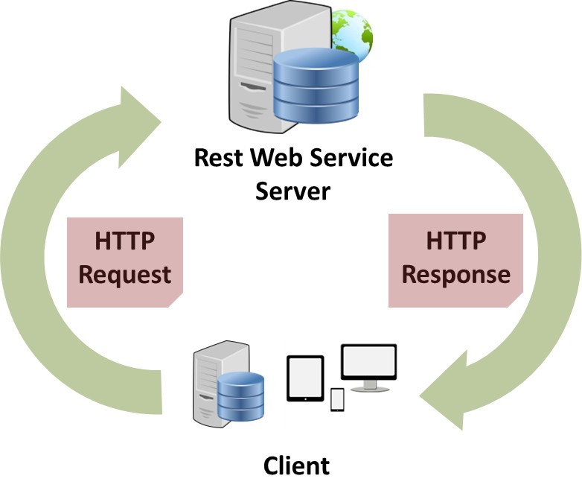
Architecture Diagram
Data Transfer from Front End HTML Page to backend MySQL DB through a REST model XAMPP WEB Service deployed using a local host.

Slide 5
System Requirements
Hardware
Processor - Intel core duo or higher
RAM - 4GB minimum
Disk - 500 GB
Monitor - 15” color with VGI card
Speed - Min 500MHz
Software
OS - Windows-10 for emulator
Editor - Visual Studio
IDLE - Python
Server - XAMPP

Slide 6
Functional Description
1. CRUD (Create)
During first time entry, an HTML page accepts first name, last name, gender, mobile number and date. Any number of records can be created.
Facility is incorporated in DB design to have Row ID as Auto Increment so that the primary key is the row id which is not visible as a column. So no need for validation on the uniqueness of the record.

Slide 7
Functional Description
2. CRUD (Read/Update)
To inquire about a record, a JINJA template in HTML is used and records are displayed with hyperlink reference for editing an existing record and deleting a record from the database in the home page.
The same screen is used for Editing/Modifying an existing record in the DB.

Slide 8
Functional Description
3. CRUD (Delete)
To delete a record, a JINJA template in HTML is used and records are displayed with hyperlink reference for editing an existing record and deleting a record from the database in the home page and deletion is done through this page with no other extra page to navigate.

Slide 9
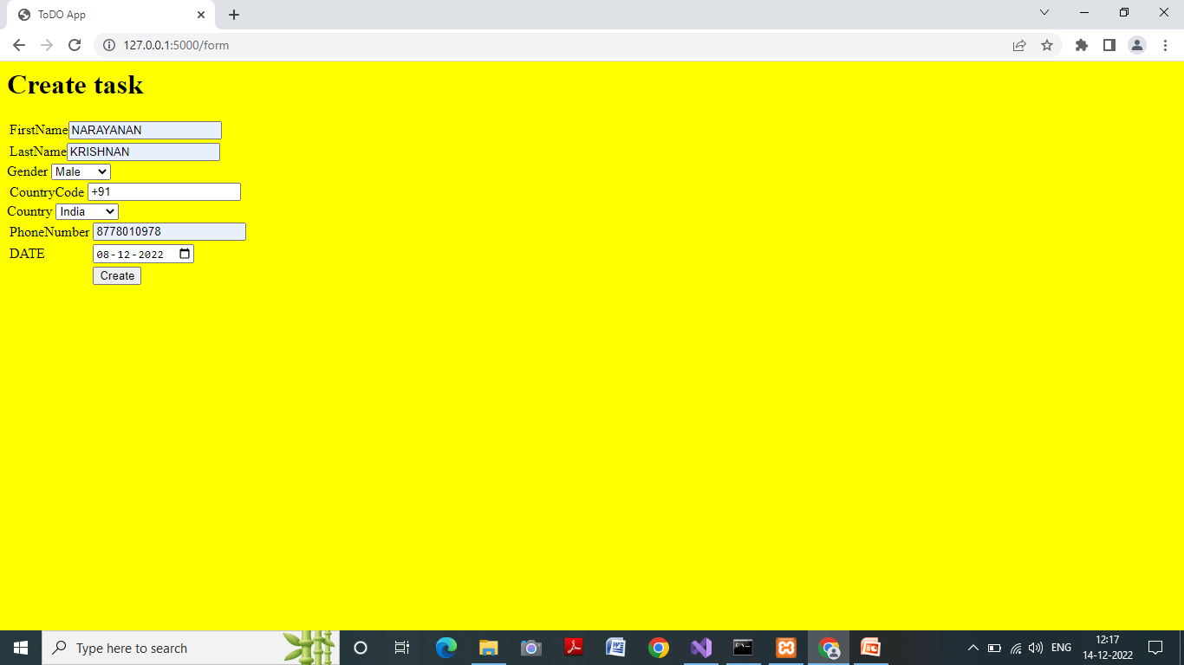
Screens
IMPLEMENTATION
Creation :

Slide 10
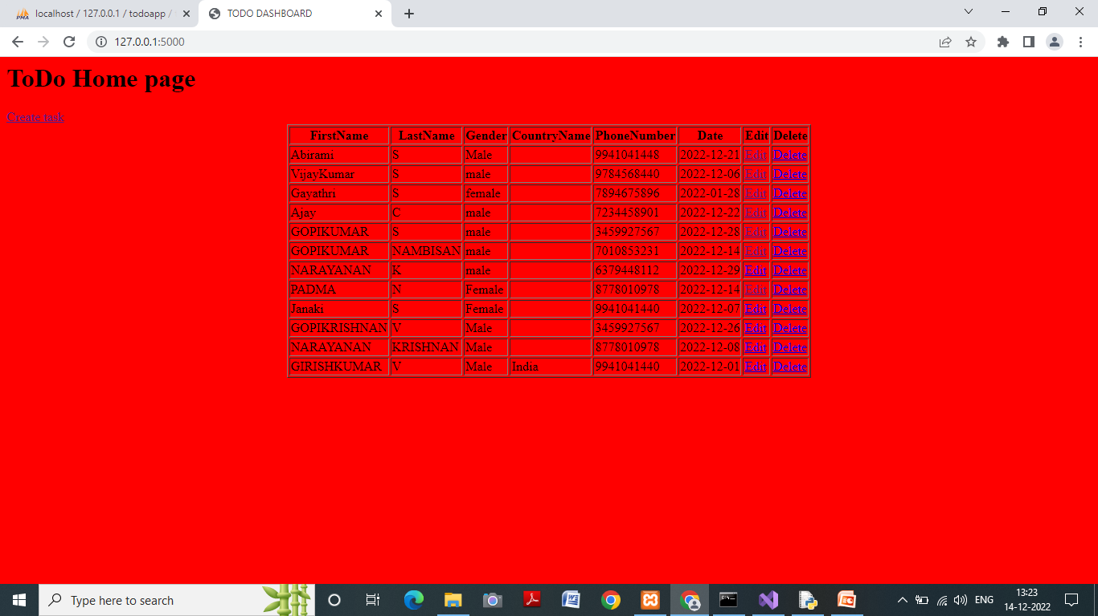
Screens
Creation : Created Entries showing in the Home Page
IMPLEMENTATION

Slide 11
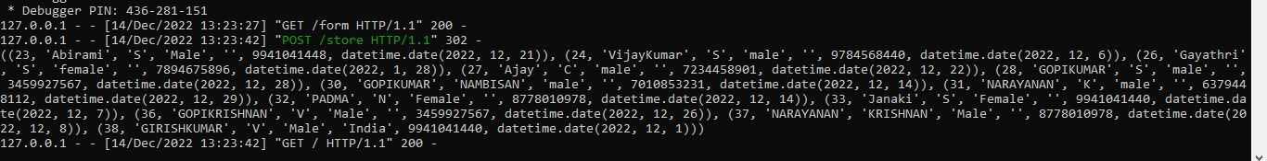
Screens
IMPLEMENTATION
Read / Select: Records shown in Command Prompt

Slide 12
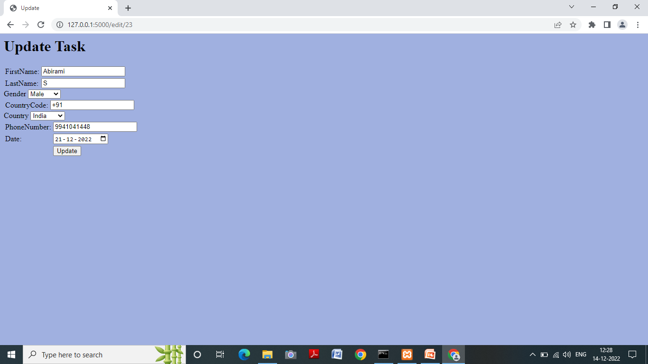
Screens
Read / Update:
IMPLEMENTATION

Slide 13
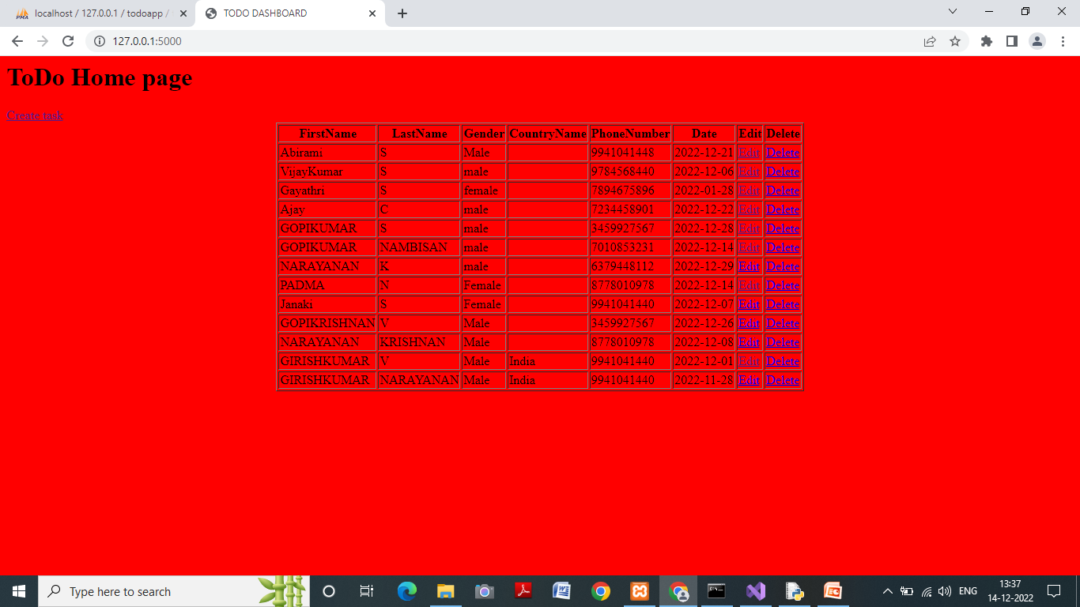
Screens
IMPLEMENTATION
Update : Updated Entries showing in the Home Page

Slide 14
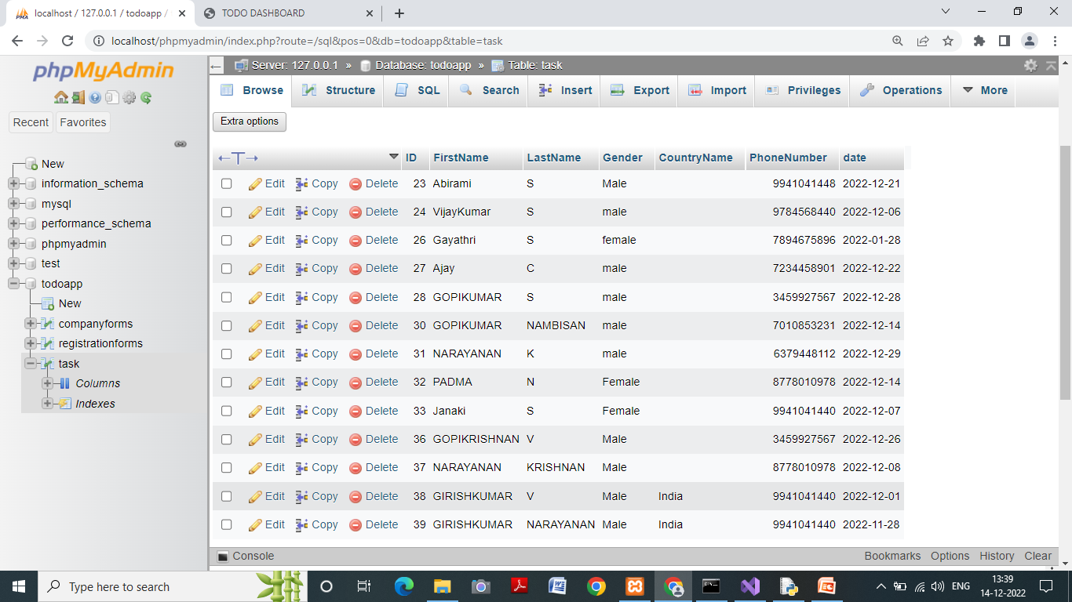
Screens
IMPLEMENTATION
Update : Updated Entries showing in the Database

Slide 15
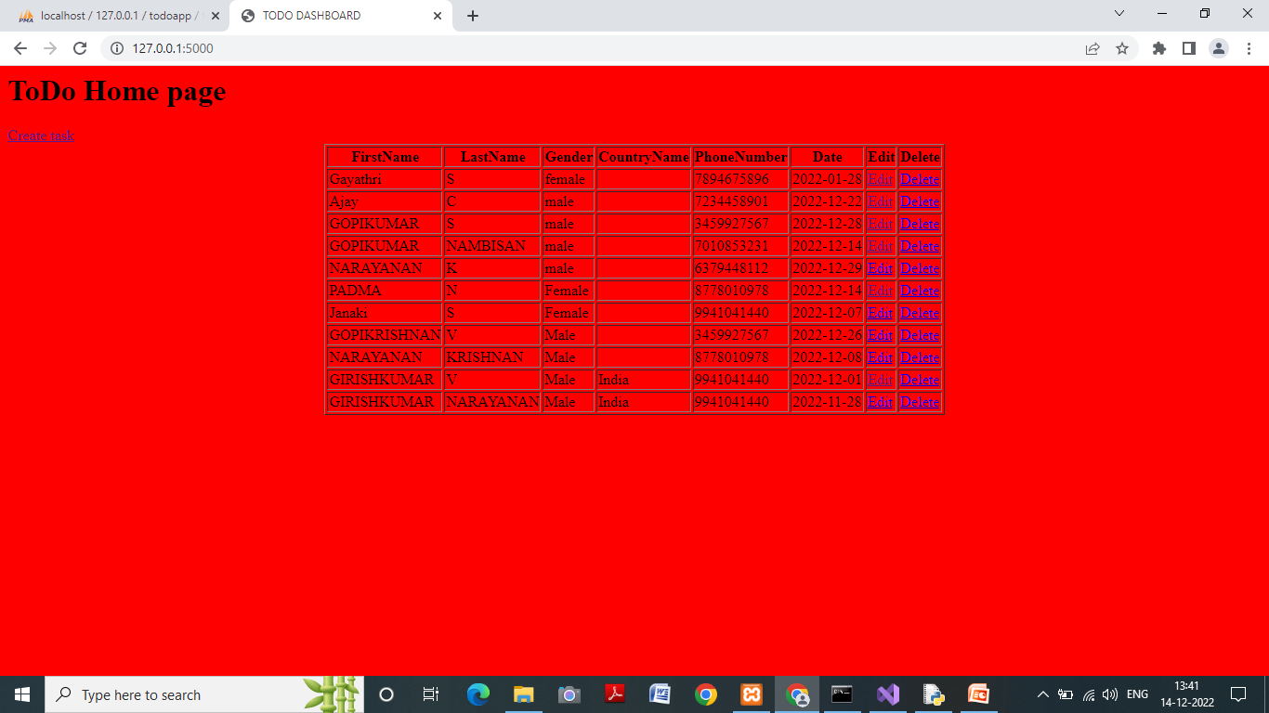
Screens
IMPLEMENTATION
Delete : Deleted Entries not showing in the Home Page

Slide 16

Screens
IMPLEMENTATION
Delete : Deleted Entries not showing in the Database

Slide 17
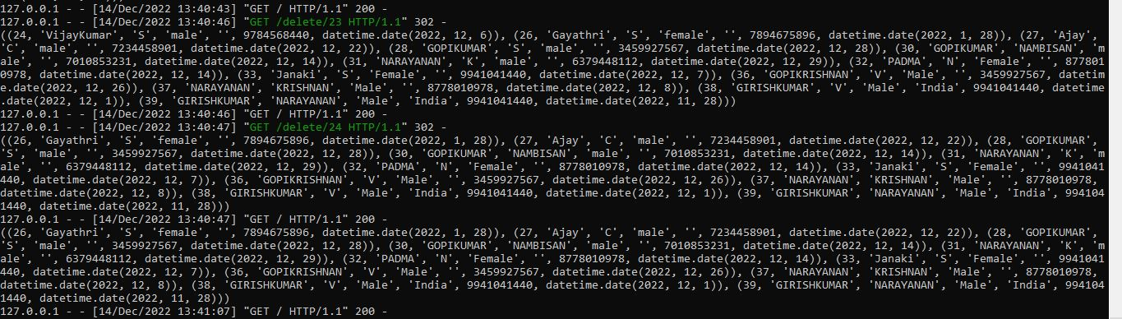
Screens
IMPLEMENTATION
Delete: Deleted Records shown in Command Prompt

Slide 18
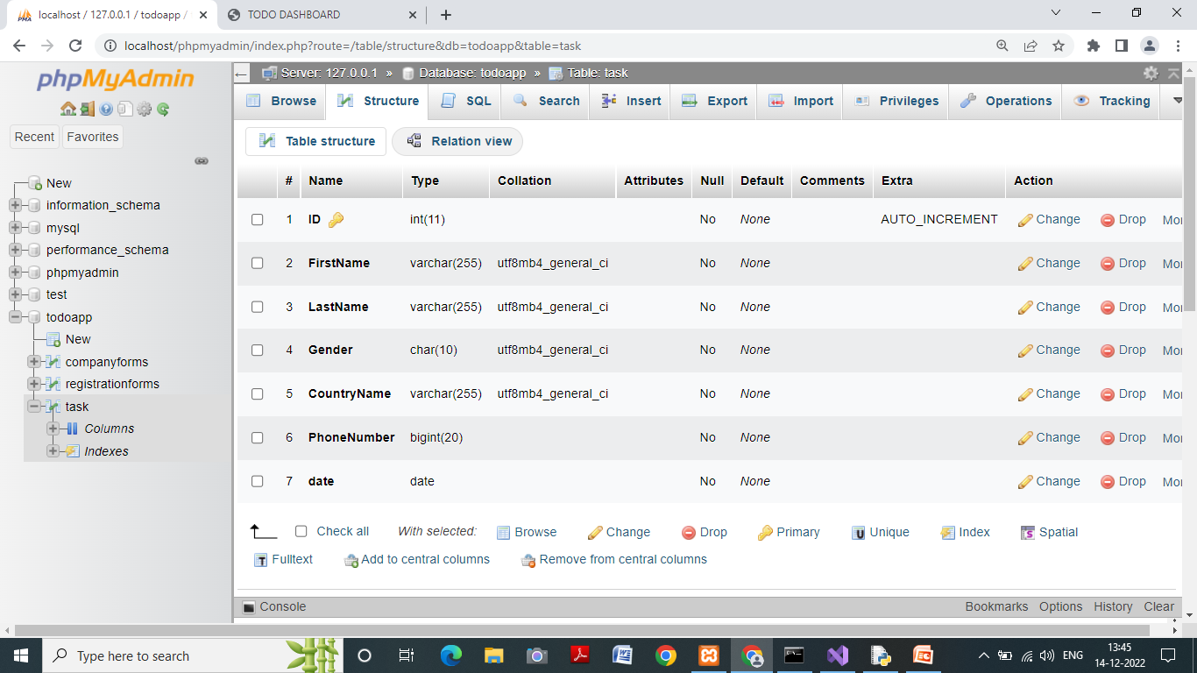
Screens
IMPLEMETATION
Database Structure:

Slide 19
Thank You

